Slide 1
TOPIC:-
Difference Between 26AS,AIS,TIS
Submitted To :- Shashwat Singhal Submitted By:- Unnati Chaurasia

Slide 2
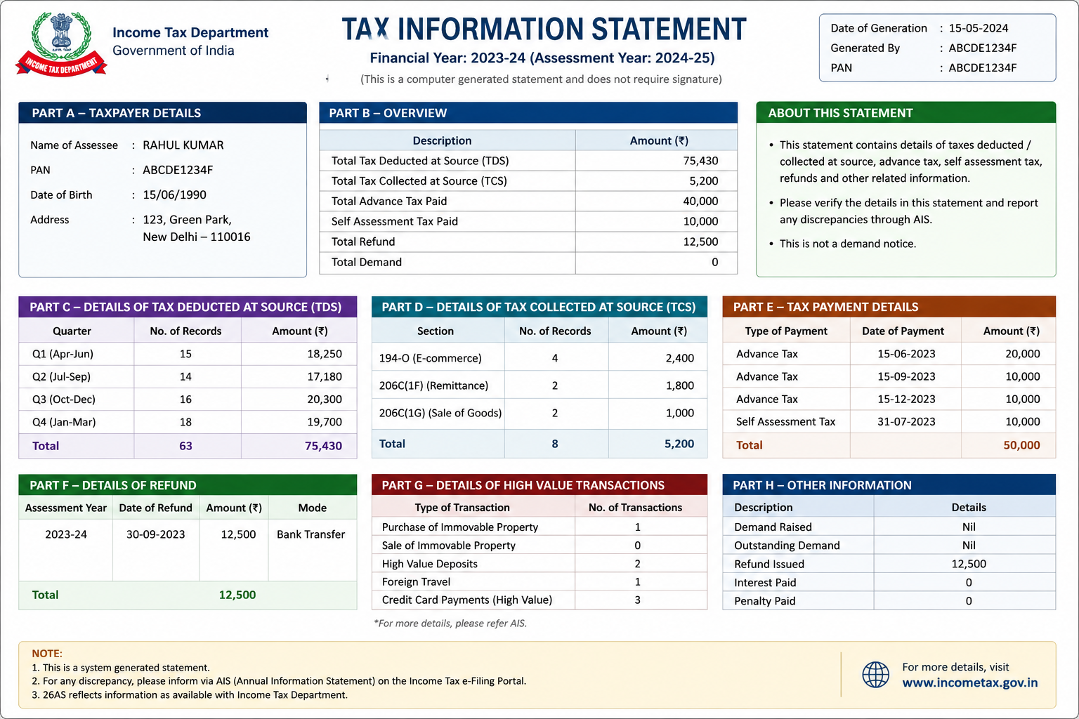
INTRODUCTION
What are Tax Information Statements?
Issued by the Income Tax Department.
Help taxpayers verify tax-related information.
Improve transparency in tax filing.
Reduce errors while filing Income Tax Returns (ITR).
Include Form 26AS, AIS, and TIS.

Slide 3
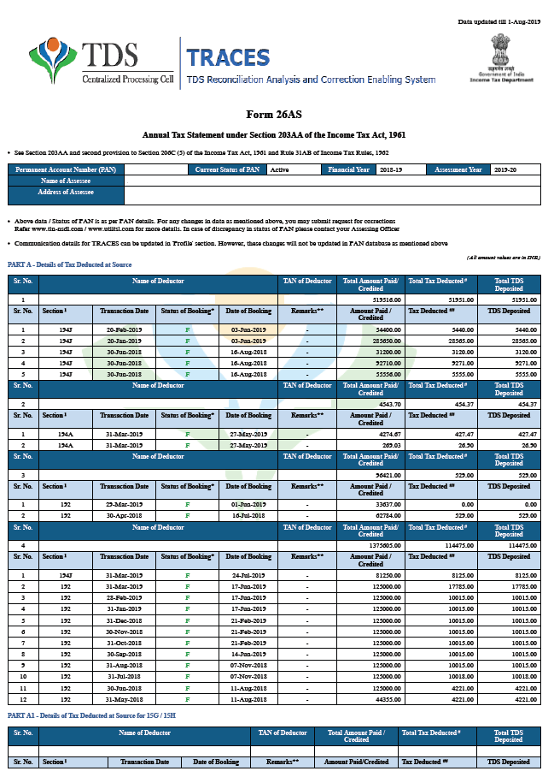
ANNUAL TAX STATEMENT (26AS)
Form 26AS is a consolidated annual tax statement issued by the Income Tax Department of India. It is linked to a taxpayer's Permanent Account Number (PAN) and provides a complete record of taxes deducted, taxes collected, tax payments made, and refunds received during a financial year. It helps taxpayers verify that the taxes deposited on their behalf have been correctly credited before filing their Income Tax Return (ITR).

Slide 4
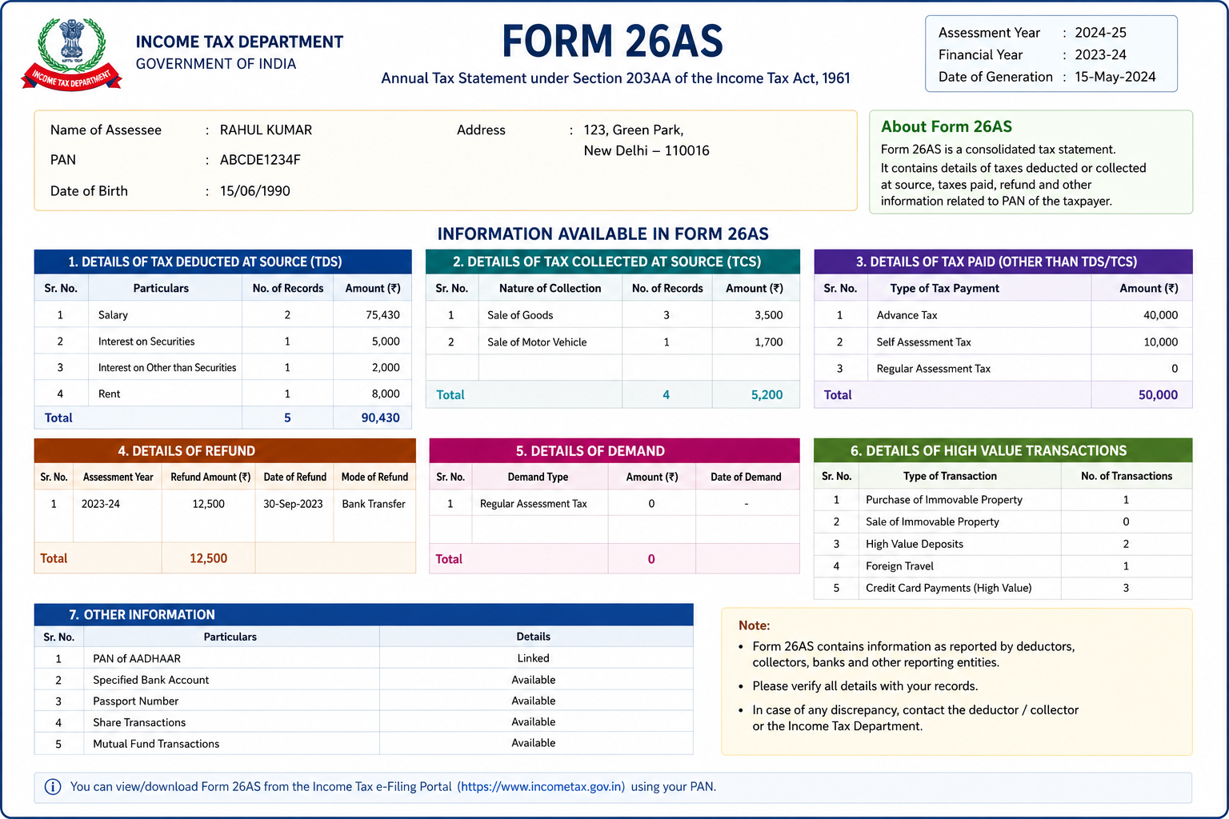
INFORMATION AVAILABLE IN FORM 26 AS
Tax Deducted at Source (TDS)
Tax Collected at Source (TCS)
Advance Tax Paid
Self-Assessment Tax
Income Tax Refund Details
High-value transactions
Demand and refund information

Slide 5
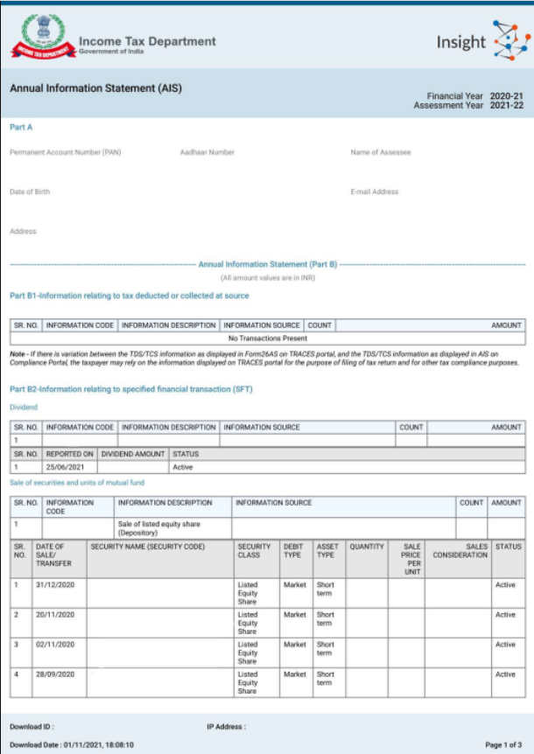
ANNUAL INFORMATION SYSTEM
The Annual Information Statement (AIS) is a comprehensive financial statement issued by the Income Tax Department of India. It provides detailed information about a taxpayer's financial transactions during a financial year. AIS includes both tax-related (such as TDS, TCS, and tax payments) and non-tax-related information (such as interest income, dividends, mutual fund transactions, property transactions, and foreign remittances). It helps taxpayers verify their financial records, report accurate income, and file error-free Income Tax Returns (ITR). AIS also allows taxpayers to provide feedback if any information is incorrect.

Slide 6
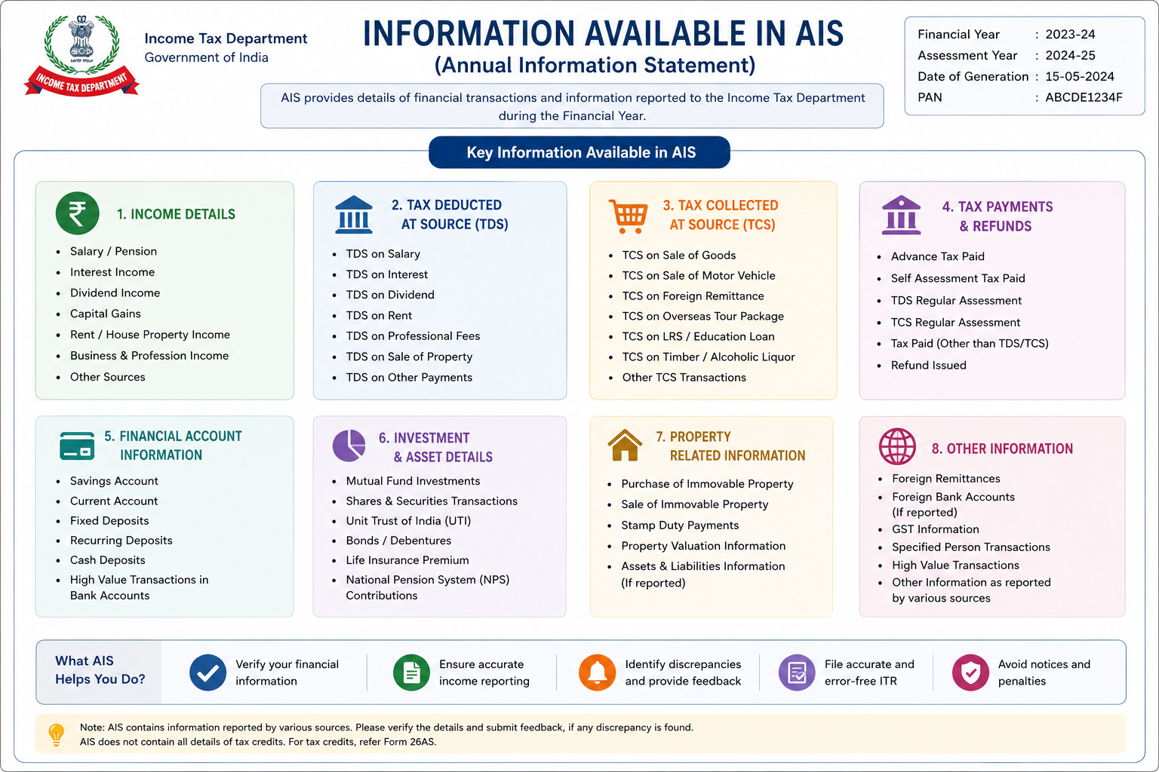
INFORMATION AVAILABLE IN AIS
Salary Income
Interest Income
Dividend Income
Securities Transactions
Mutual Fund Transactions
Property Purchase/Sale
Foreign Remittance
GST Information
Tax Payments
TDS/TCS Details

Slide 7
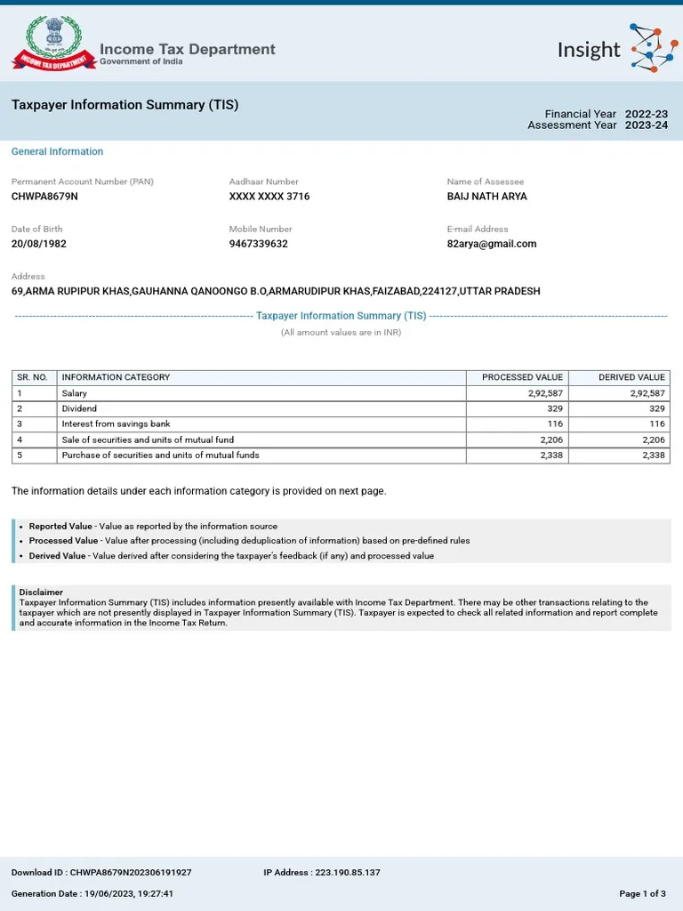
TAXPAYER INFORMATION SUMMARY
The Taxpayer Information Summary (TIS) is a summary of the Annual Information Statement (AIS) issued by the Income Tax Department. It provides processed and updated financial information such as salary, interest, dividends, capital gains, TDS, TCS, and tax payments. TIS reflects the taxpayer's feedback submitted through AIS and helps in quick, easy, and accurate Income Tax Return (ITR) filing.

Slide 8
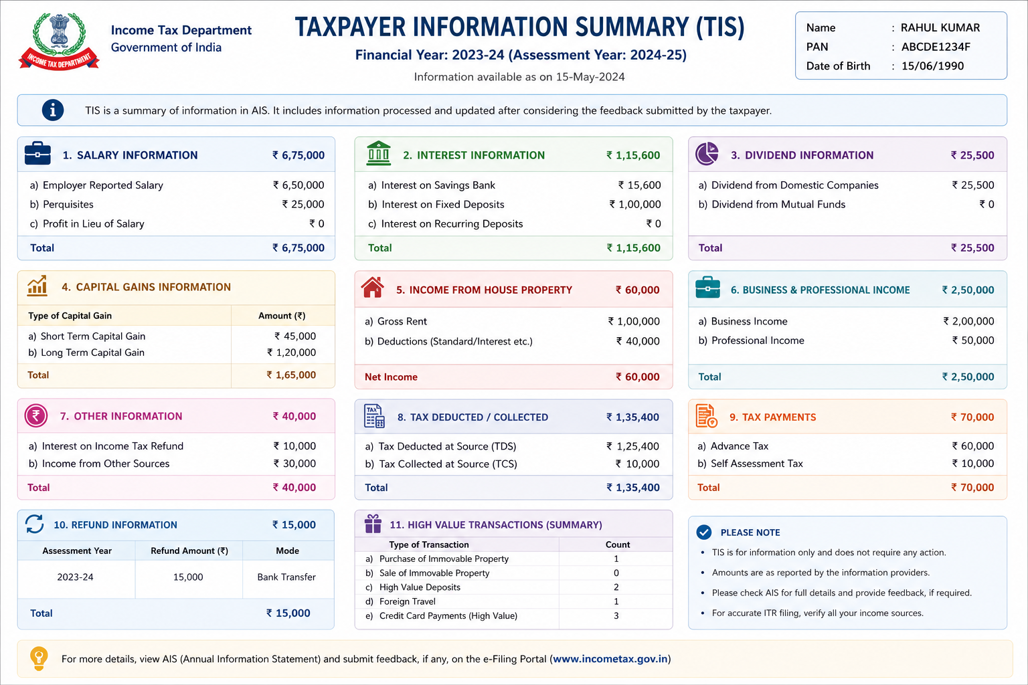
INFORMATION AVAILABLE IN TIS
Salary
Interest Income
Dividend Income
Capital Gains
Business Income
Tax Payments
TDS
TCS
Other Income

Slide 9
DIFFERENCE BETWEEN FORM 26AS, AIS & TIS
Basis | Form 26AS | AIS | TIS
Meaning | Annual tax statement showing tax credits. | Detailed financial statement. | Summary of AIS.
Purpose | Verify taxes deducted, paid, and refunds. | Report complete financial information. | Simplify ITR preparation.
Information | TDS, TCS, tax payments, refunds. | Salary, interest, dividends, investments, property, TDS, TCS, etc. | Summarized income and tax details.
Detail Level | Limited | Detailed | Summarized
Feedback | No | Yes | Updated based on AIS feedback.
Main Use | Check tax credits. | Verify all financial transactions. | Easy and accurate ITR filing.

Slide 10
PRACTICAL EXAMPLE
Example
Rahul's salary = ₹8,00,000
Additional Income:
Interest = ₹20,000
Dividend = ₹10,000
Mutual Fund Sale = ₹50,000
Form 26AS
Shows TDS deducted.
AIS
Shows salary, interest, dividend, mutual fund transaction.
TIS
Shows summarized income for ITR filing.

Slide 11
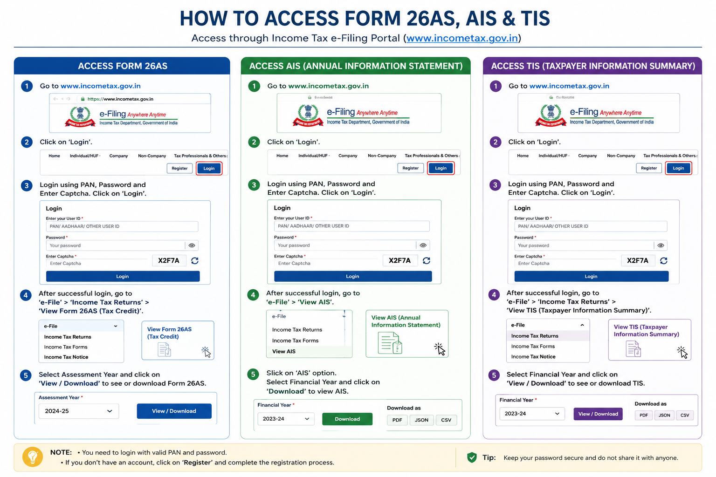
HOW TO ACCESS (FORM26AS, AIS, TIS)
Visit the Income Tax e-Filing Portal.
Log in using PAN and password.
Go to Services.
Select AIS or View Form 26AS.
Download the required statement.

Slide 12
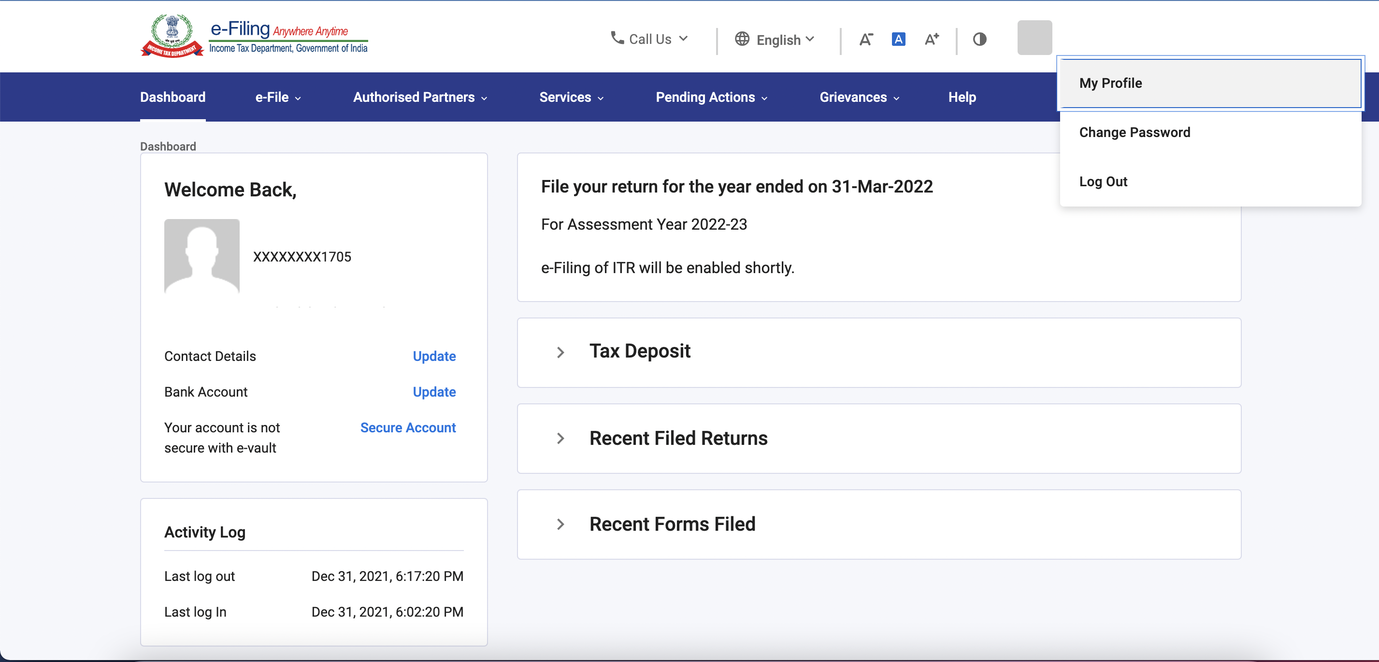
CONCLUSION
Form 26AS provides tax credit details.
AIS provides complete financial information.
TIS provides a summarized version of AIS.
All three statements help in accurate Income Tax Return filing.
Reviewing these statements before filing ITR ensures transparency and reduces errors.

